Slide 1



EagleSat-I
Mission Overview
Delbert Conn
Embry-Riddle Aeronautical University Aeronautical Engineering, Senior
Presentation for
AZ/NASA Space Grant Symposium
April 21-22, 2017

Slide 2
Overview
Mission Statement
Mission Objectives
Design
Construction & Integration
Testing
Future Work

Slide 3
Mission Statement
EagleSat will be the first student designed and managed undergraduate satellite development program at Embry-Riddle with the purpose of performing scientific research and encouraging student development.
Primary (Program) Objective
Provide an educational experience for students both directly involved and through outreach that will complement classroom learning, the primary focus for every member.
Secondary (Science) Objectives
The study of the satellite’s orbital decay throughout the mission lifecycle, as measured and reported by an on-board global positioning system (GPS).
Notes:
Launch: August 29, 2017 with ElaNa14

Slide 4
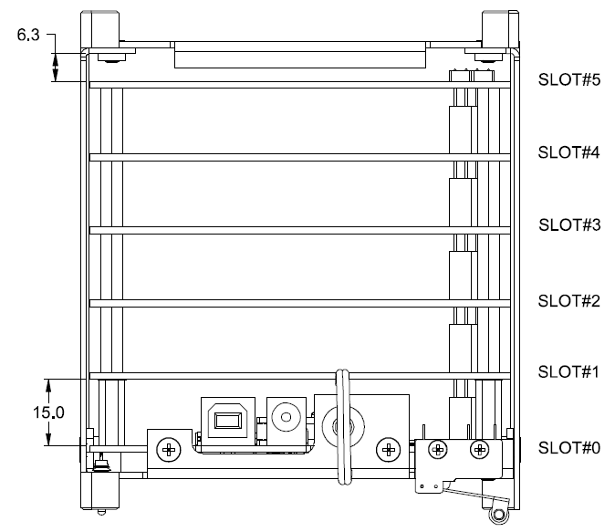
Design: Overview
GPS
Comms
Burn Wire
EPS
OBC
+Z
+X
+Y
Pumpkin, Inc. (2003). Pumpkin CubeSat Kit User Manual. Rev. D2, 13.

Slide 5
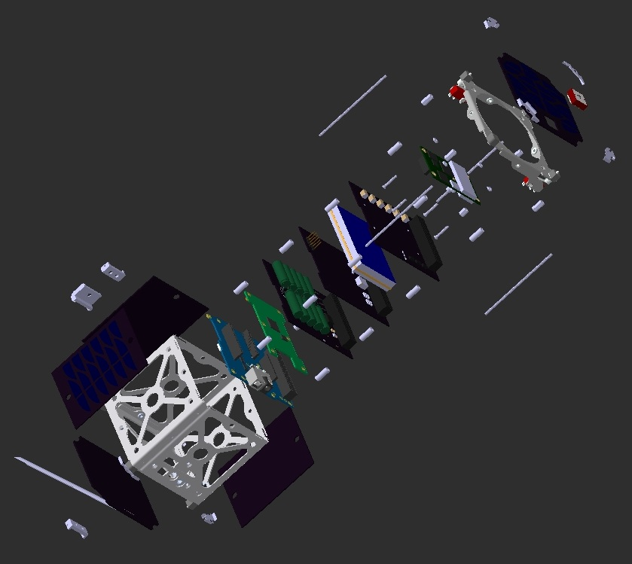
Design: CATIA

Slide 6
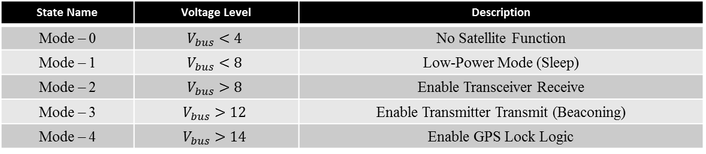

Design: Software
Main Objective: To capture GPS position data and store for later downlink
Bus voltage driven logic
$V_{bus}$ is determined by a voltage divider on the EPS

Slide 7
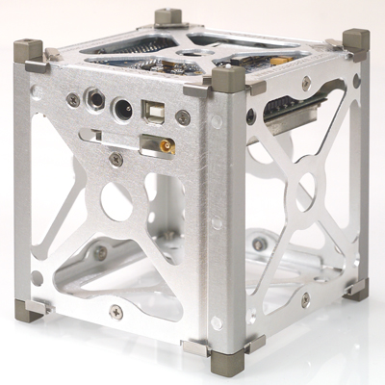
Construction: Structure & OBC
Pumpkin Structure and OBC

Slide 8
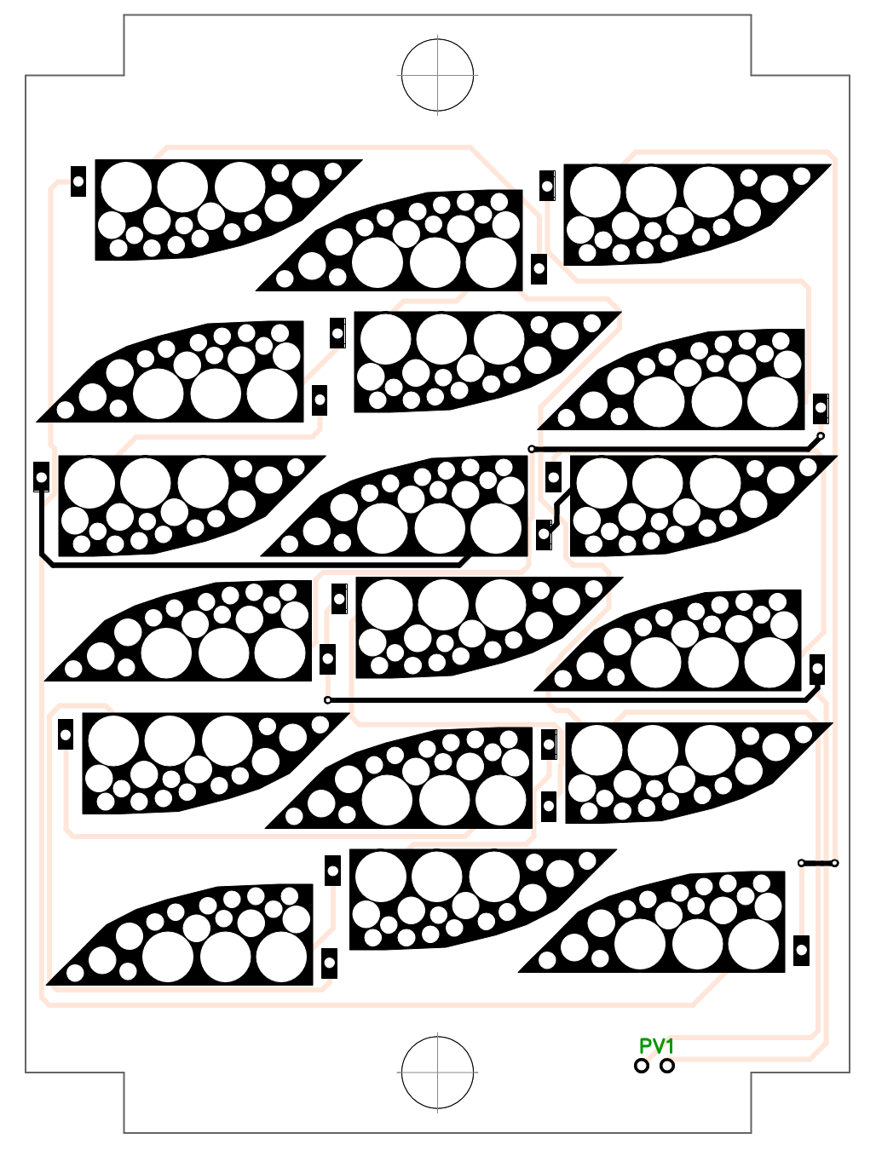
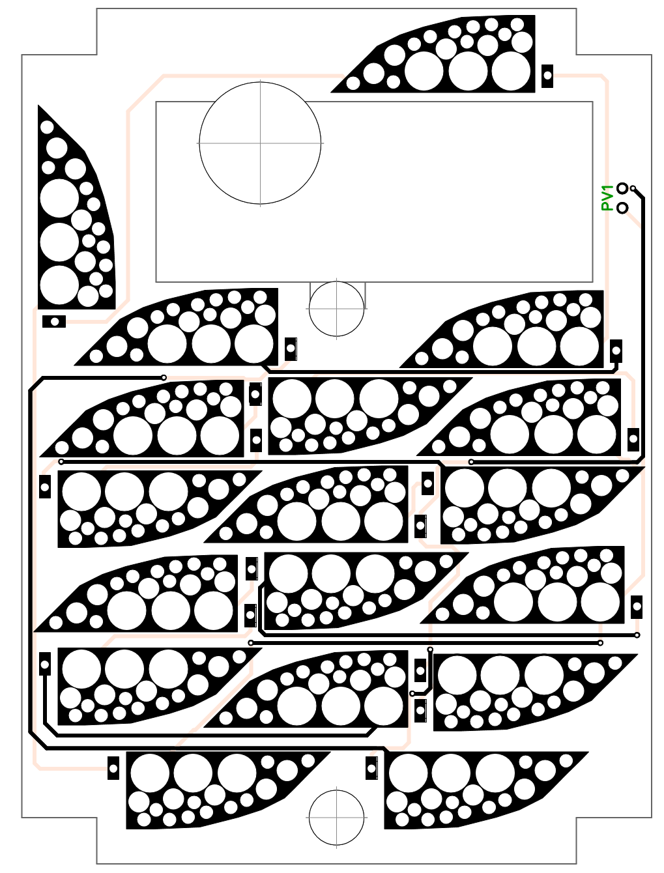
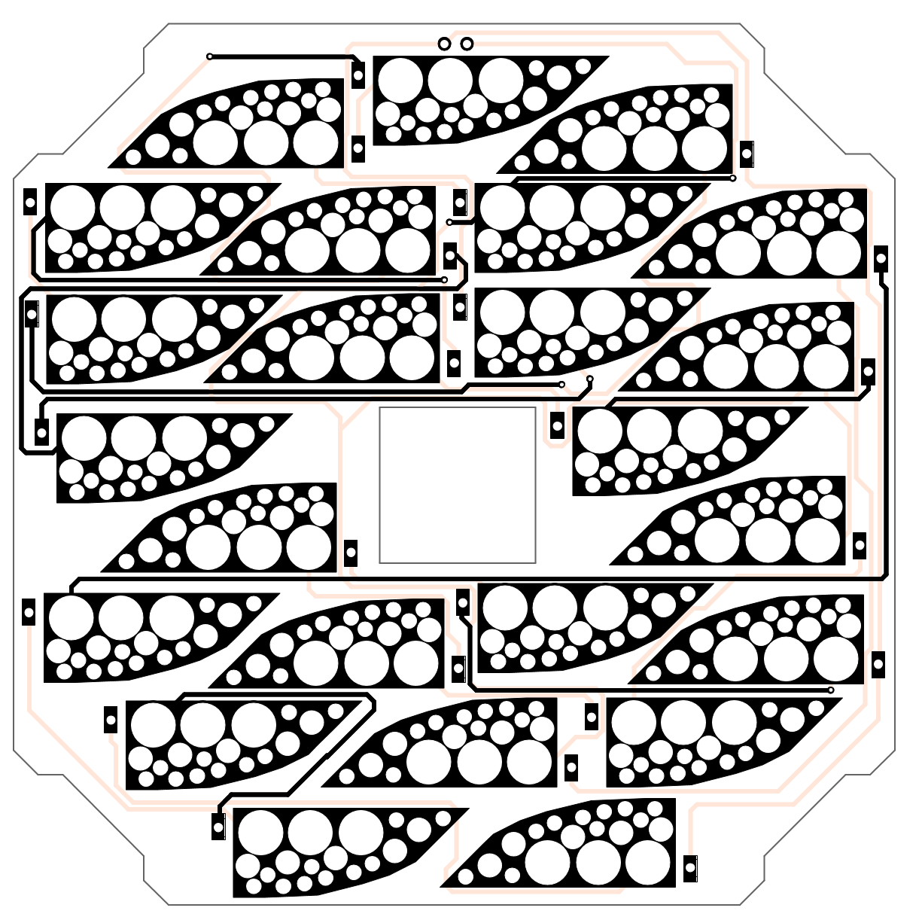

Construction: Solar Cells
$±$Y Panel
-Z Panel
+X Panel

Slide 9
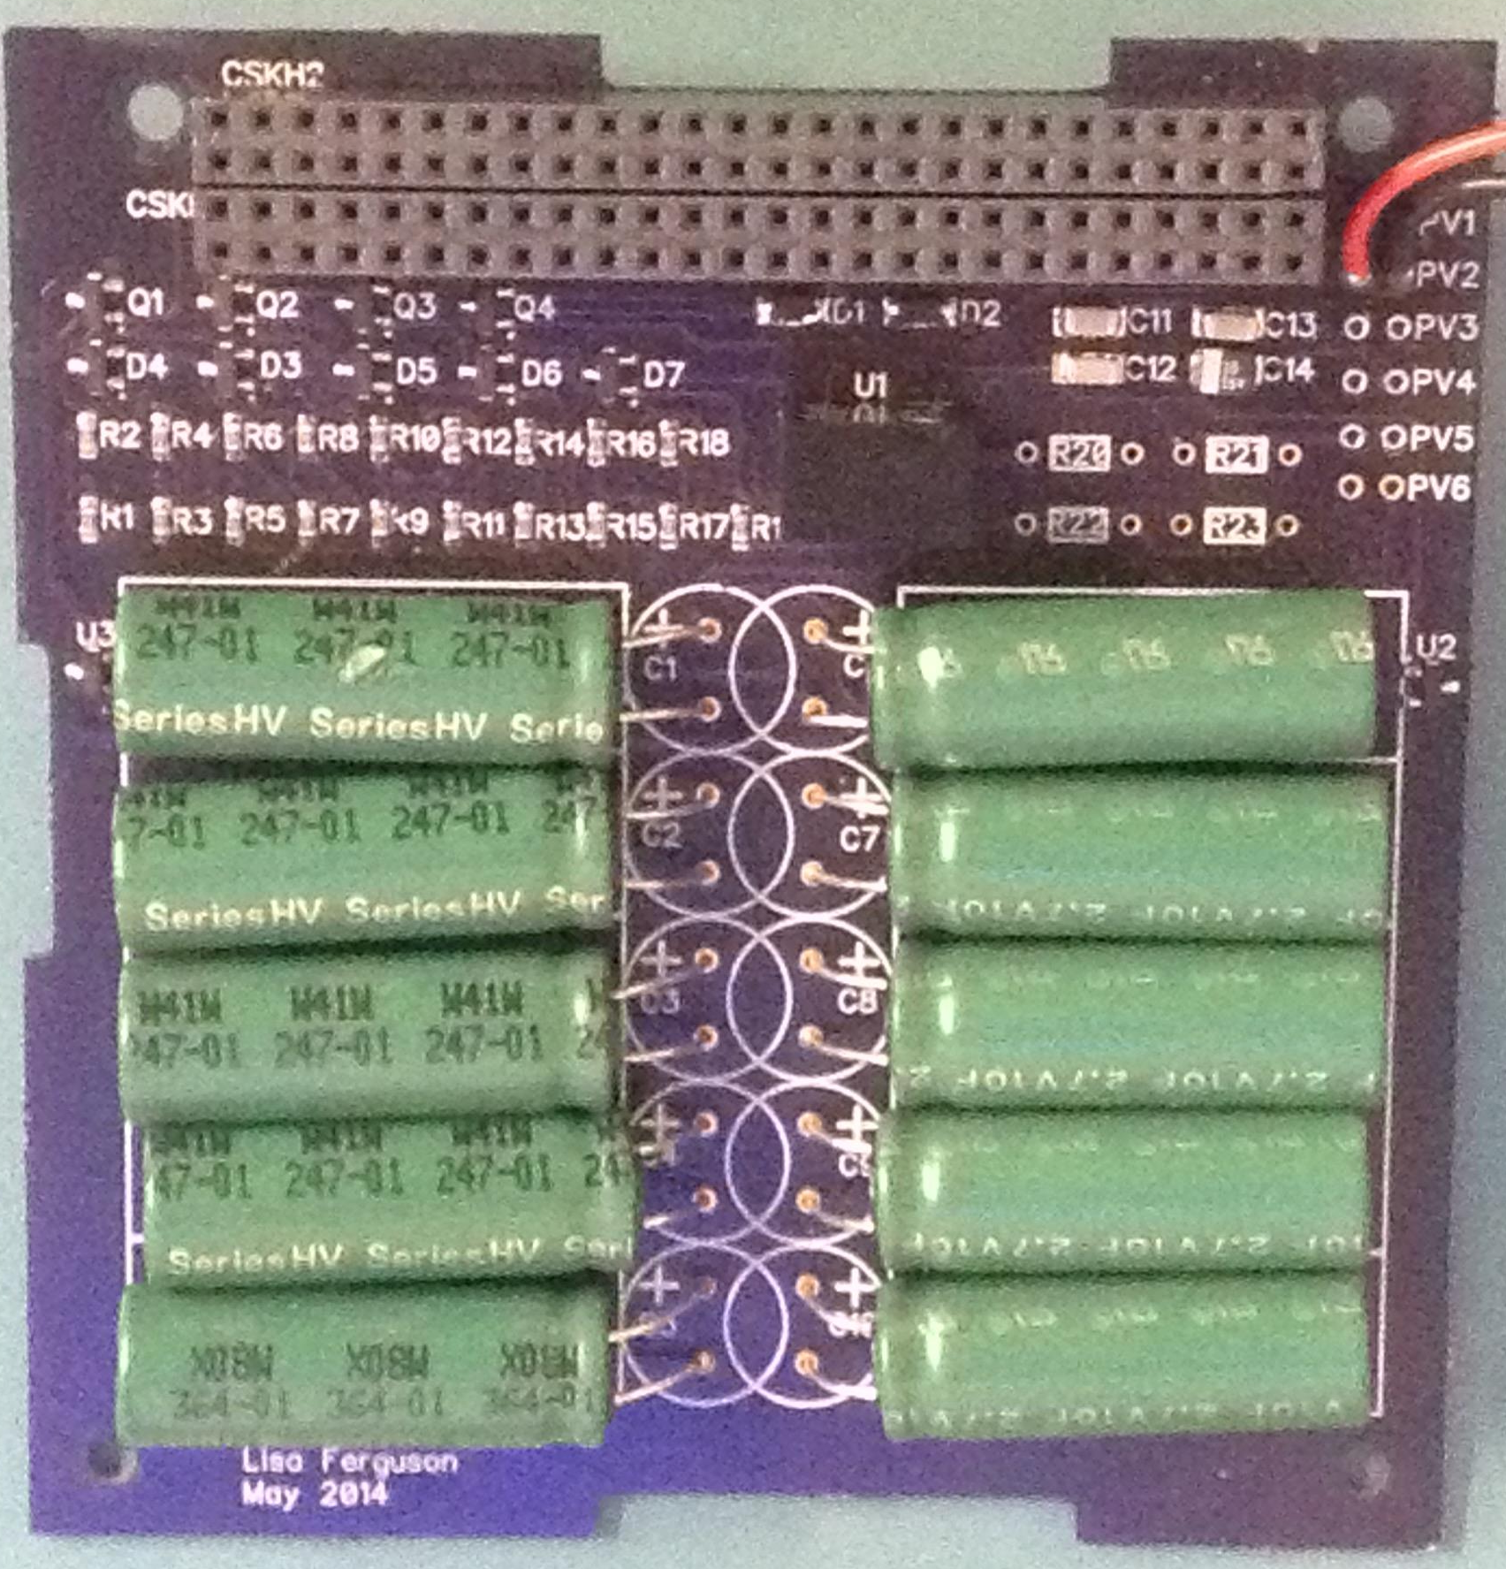
Construction: Power
Eaton HV1030-2R7106-R 10F (3V)
Supercapacitors
Provides 4F (15V)

Slide 10
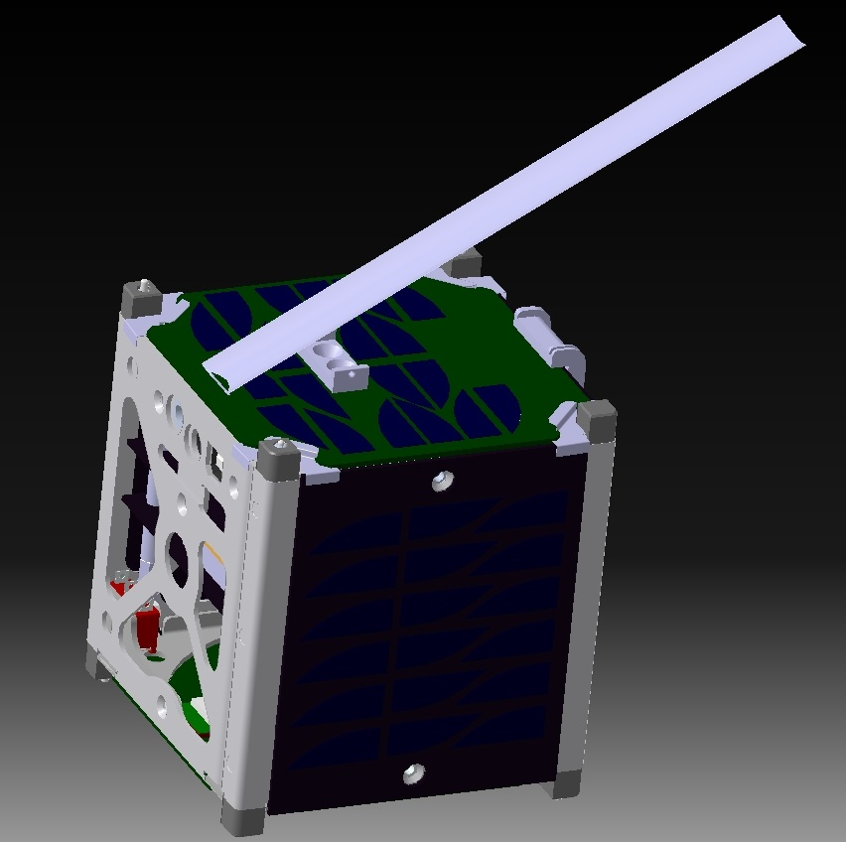
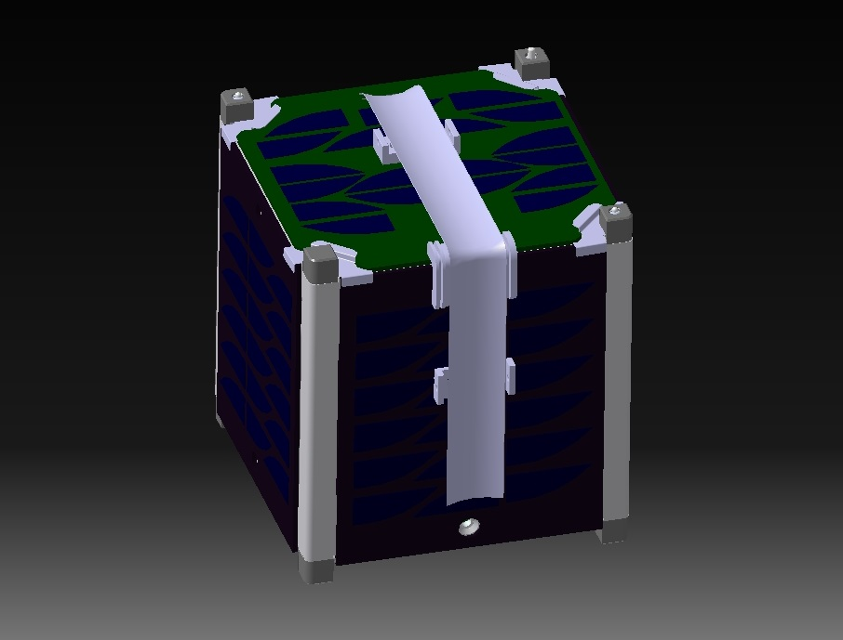
Construction: Antenna
Shows the placement and direction of the antenna when it is deployed.
Shows how the antenna will wrap around the satellite when it is stored.
- monofiliment line
- nichrome wire

Slide 11
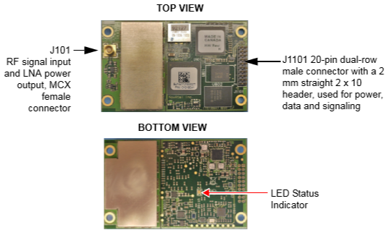
Construction: GPS
Novatel OEM615

Slide 12
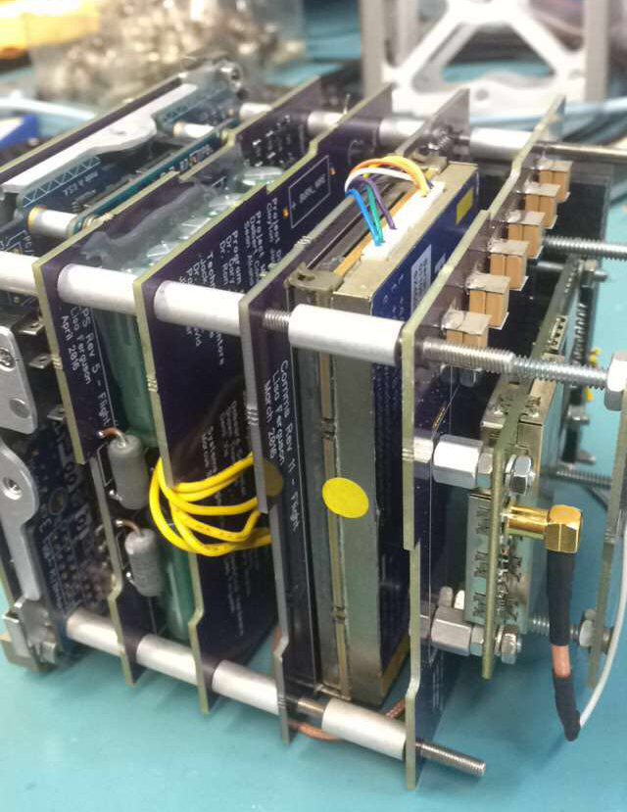
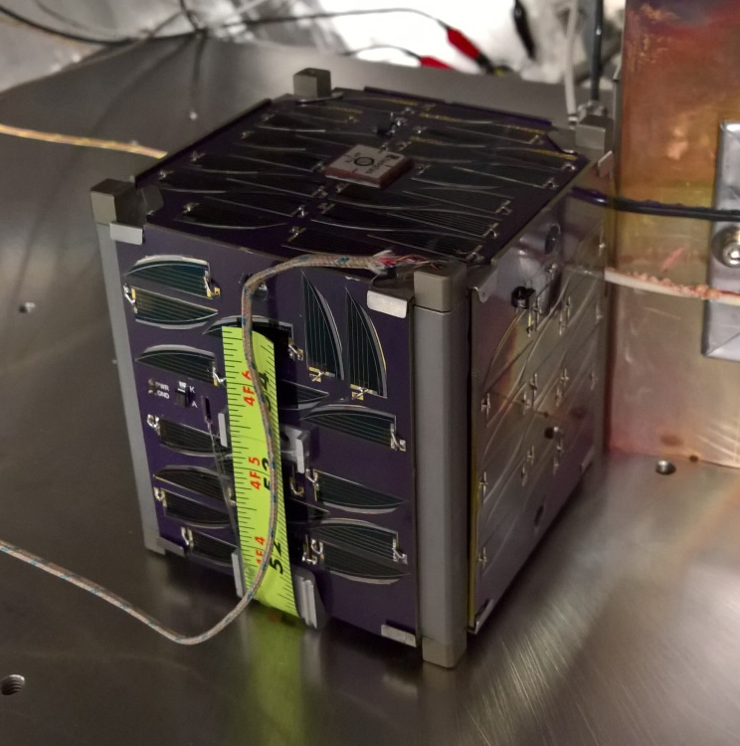
Testing

Slide 13
Testing
4 Types of tests:
  Day In The Life: Software verification
  Thermal Bakeout: Outgassing
  Random Vibration: Launch Vehicle
  Shock: Launch Vehicle

Slide 14
Future Work
Final Document Review
Launch September 21st
Data collection

Slide 15





Acknowledgements
Dr. Gary Yale
EagleSat-1 Team
Embry-Riddle Aeronautical University
NASA Arizona Space Grant
Wood & Douglas (UK)
Ignite Undergraduate Research
Arizona Near Space Research

Slide 16
Questions
Please feel free to contact me:
Delbert Conn
Delbert.conn@gmail.com

